Slide 1
Climate Change
Thompson, Stephen, Laura, Sagar, Trevor (Peter and Alan in spirit)

Slide 2
UCSD Data Analysis Bootcamp by Trilogy
Authors contact information
Trevor J. Kleinstuber
Laura Paakh
Sagar Patel
Thompson Tang
Stephen Hong
trevor.kleinstuber@gmail.com
laurapaakh@gmail.com
ucsddatacamp@gmail.com (for sale)
thientoan809@gmail.com
hongsulbum@gmail.com
This slideshow is released under a Creative Commons 3.0 License.
You are free to share this slideshow for non-commercial purposes with attribution.

Slide 3
What questions can we answer?
-Is rideshare affecting gas usage?

Slide 4
Data Availability changed the scope of our investigation
-Private data e.g. Uber
-Uncollected Data e.g.
Energy consumption by Zip Code

Slide 5
Sources
OECD
GISS Surface Temperature (GISTEMP)
Climate at a Glance (GCAG).
U.S. Energy Information Administration
EM-DAT, the International Disaster Database.
The World Bank

Slide 6

Does oil consumption truly impact climate change?
Let’s compare energy consumption and the world’s temperature!

Slide 7
Questions we end up asking
City vs Rural
Relationship between population density and energy consumption?
Disasters
Is there a relationship between climate change and disaster impact size?
Transit
Is there a relationship between transit usage and other data?

Slide 8

DATA CLEANUP & EXPLORATION
Exploration and cleanup:
Observe
Import
Clean
Insights and issues:
Data structure
Merging
Let’s take a quick peek at what is coming up!

Slide 9
1 quadrillion BTU is enough power to run
17,584,264,210,333 light bulbs for 1 hour!
Each household in the US would be able to have enough light bulbs for 3,039 years if they replaced an average of 45 light bulbs per household per year.

Slide 10

Problems working with data
Country name differences
Climate Subgroup
Vast empty data

Slide 11
Challenges in using data
Formatting
Different data sets have country names spelled slightly differently.
Time Range
Different datasets cover different time periods.
1986-2016
Structure
Data sets from different sources have varying structure

Slide 12
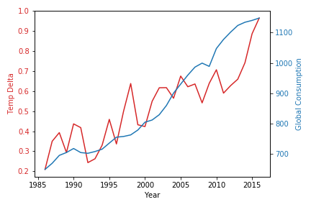
The increase in energy consumption seems to correlate very closely with the amount of climate change we are experiencing

Slide 13

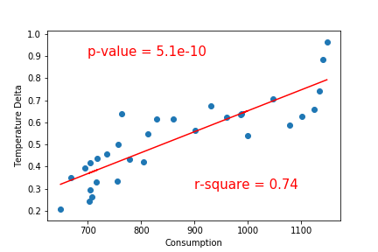
And the statistics back it up!

Slide 14

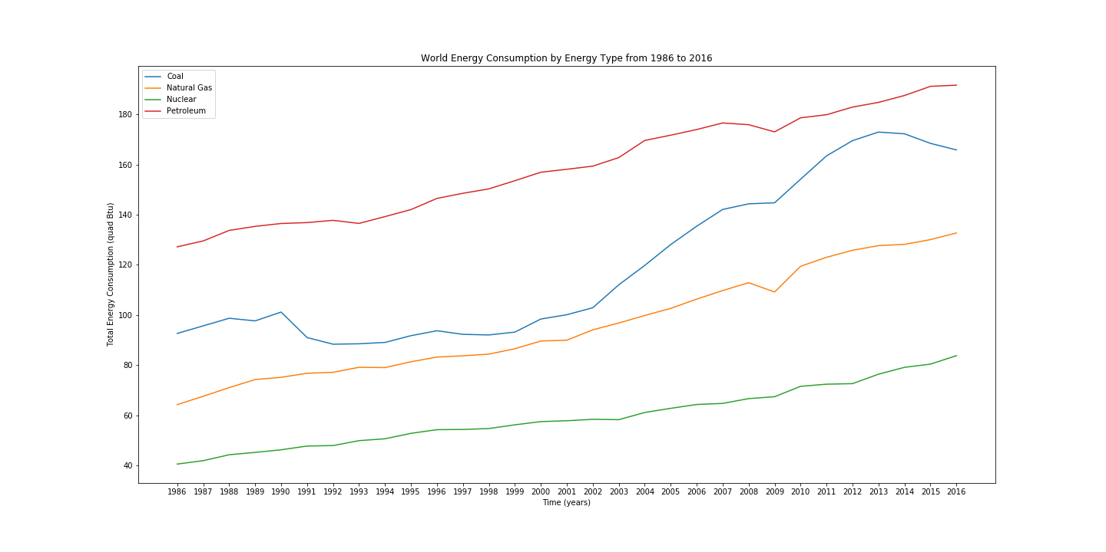
It would be good to further explore changes in the type of energy we are consuming.

Slide 15
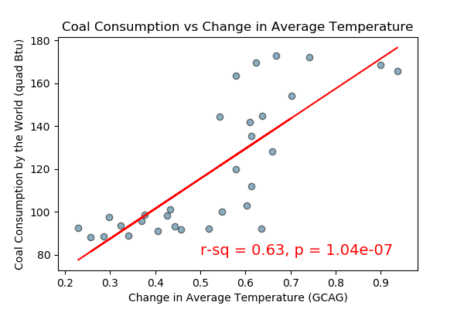
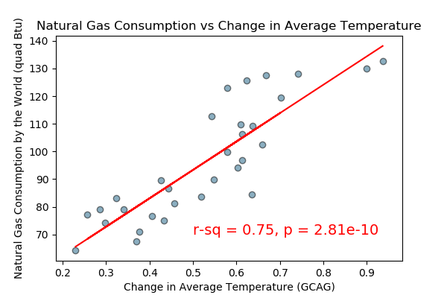
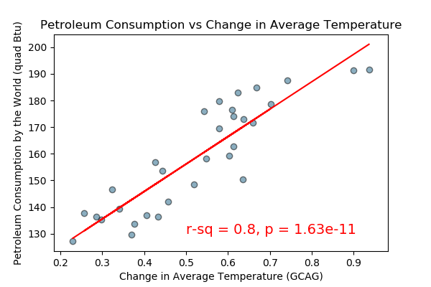
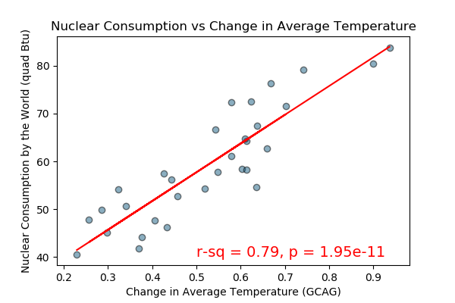
Are renewable energy sources really better for climate change?
Further research required for emerging energy consumption areas such as solar and hydrogen.

Slide 16
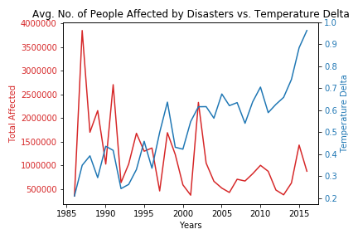
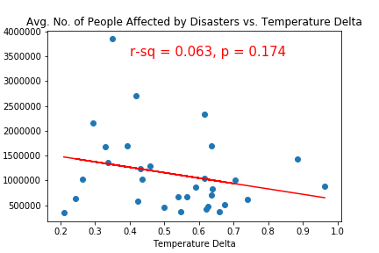
A deeper dive into the natural disasters data could also be beneficial.

Slide 17
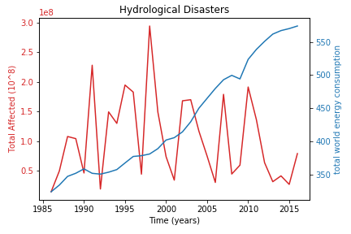
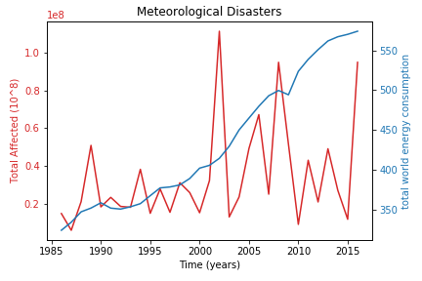
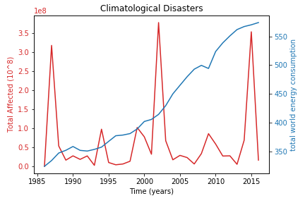
No relationship between people affected by disasters and energy consumed for the time period we examined
Notes:
If we changed to a bigger scope (centuries), we might be able to see a correlation

Slide 18
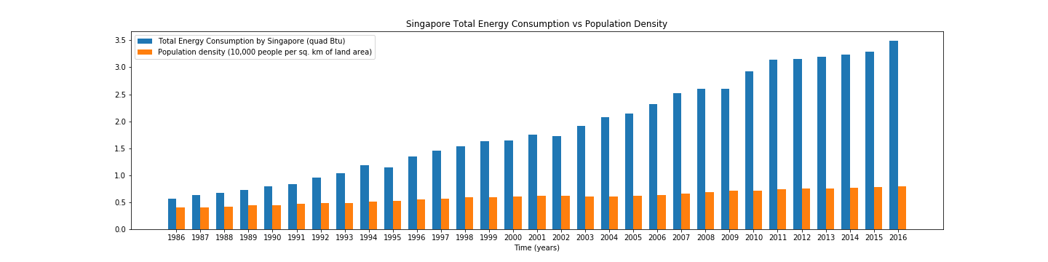
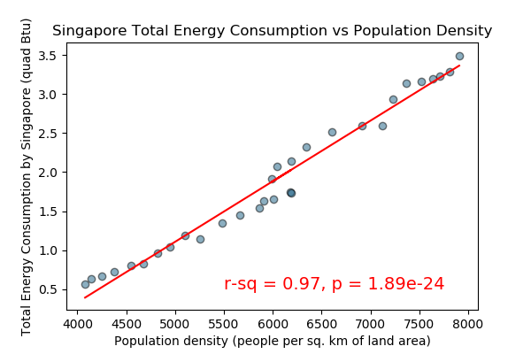
Singapore is one of the most densely populated countries in the world.
We can see a strong correlation between their population density and energy consumption.

Slide 19
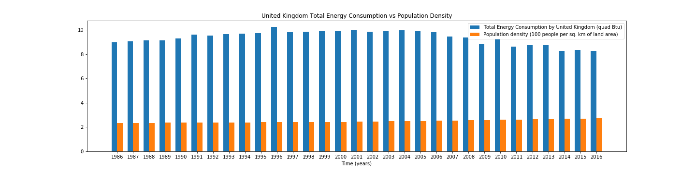
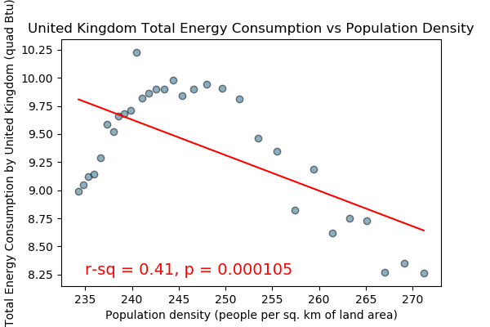
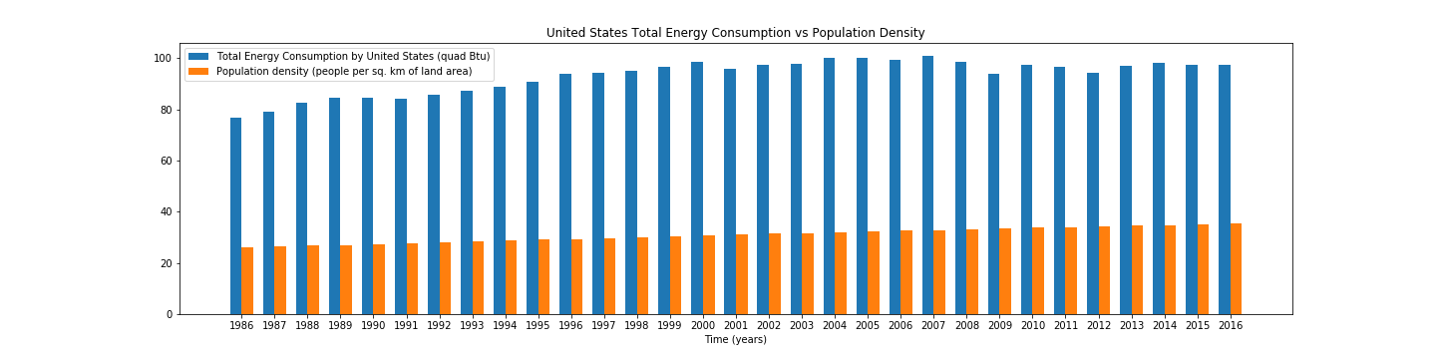
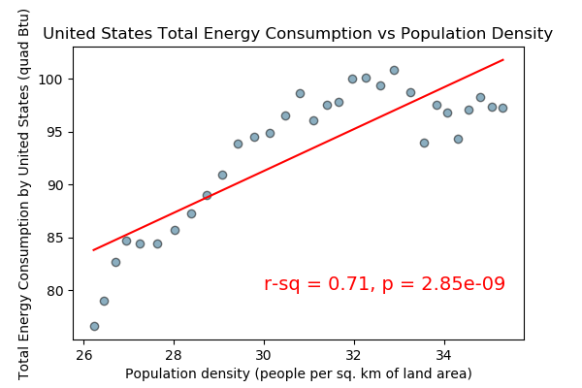
Look similar? Look again!
The UK has 100 times as many people per sq km as the US!

Slide 20

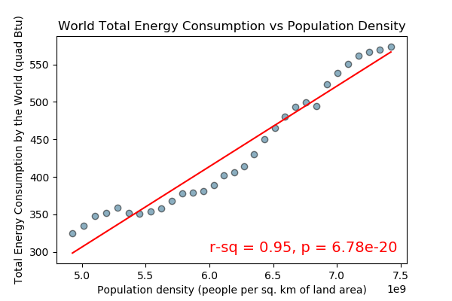
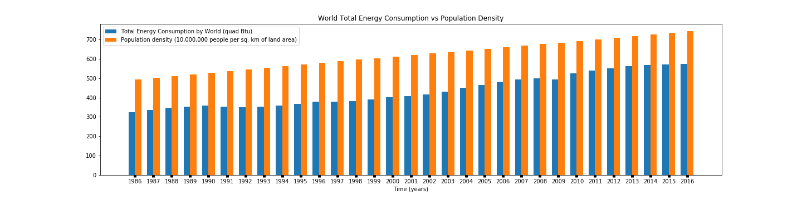
THE WORLD

Slide 21
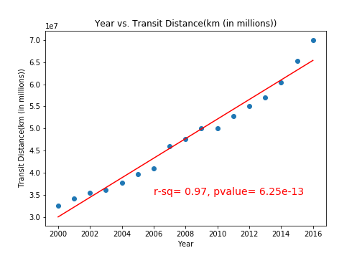
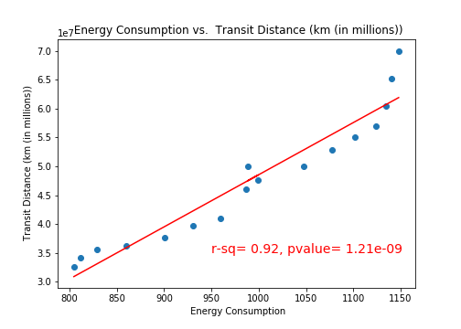
Is the total distance of transit increasing over time?
What’s the relationship between energy consumption and transit?

Slide 22
Implications
Climate change is happening.
It correlates with a number of indicators:
Population density, energy consumption.
Further investigation is necessary in:
Our disaster data
Country-level data on consumption by type and density

Slide 23
Thanks!
Any questions?

Slide 25
Credits
Special thanks to all the people who made and released these awesome resources for free:
Presentation template by SlidesCarnival
Photographs by Unsplash

Slide 26
Presentation design
This presentation uses the following typographies:
Titles: Kalam
Body copy: Merriweather
Download for free at:
https://www.fontsquirrel.com/fonts/kalam
https://www.fontsquirrel.com/fonts/merriweather
Download all the illustrated backgrounds here:
https://drive.google.com/file/d/1o22s-MVekIlxSb0Ldw_pcwMHDEnuUbT_/view?usp=sharing
You don’t need to keep this slide in your presentation. It’s only here to serve you as a design guide if you need to create new slides or download the fonts to edit the presentation in PowerPoint®

